Slide 1
When Does an Additional View Become Harmful?
Marginal Utility of Degraded Observations in Multi-View 3D Reconstruction
Minchan Kim, Yunseop Kim
Robot Vision, Term Project Proposal
Notes:
Hi everyone. Our project asks a simple question: when does adding one more image actually make a 3D reconstruction worse?

Slide 2
Motivation
Feed-forward models such as VGGT [1] predict camera poses and depth from a set of images in a single pass
Real images often contain motion blur, defocus or low light
It is already known that blur lowers reconstruction quality
Our question: is a blurry image still better than no image at all?
Or is there a blur level where adding it makes the result worse than leaving it out?
[1] J. Wang et al., “VGGT: Visual Geometry Grounded Transformer,” CVPR 2025.
Robot Vision Term Project
2
Notes:
Models like VGGT take a set of images and predict camera poses and depth in a single forward pass. In practice, some of those images are blurry. We already know blur hurts quality, so that’s not really our point. What we want to know is whether a blurry image is still better than no image at all, or whether there’s a blur level where it starts doing more harm than good.

Slide 3

Marginal Utility of an Added View
(a) Drop the target
VGGT
Error E1
(b) Add it blurred
VGGT
Error E2
Gray: context images, orange: blurred target, dashed: missing view
U = E1 − E2
(computed at each blur level)
U > 0: adding the image helps
U ≈ 0: no real effect
U < 0: better to drop it (the image is harmful)
Robot Vision Term Project
3
Notes:
To measure this, we compare two runs that use the same context images. In the first, we drop the target image and get error E1. In the second, we add the target with some blur and get error E2. The difference, U equals E1 minus E2, tells us whether adding the image helped. We compute U at every blur level, so we get a curve.

Slide 4
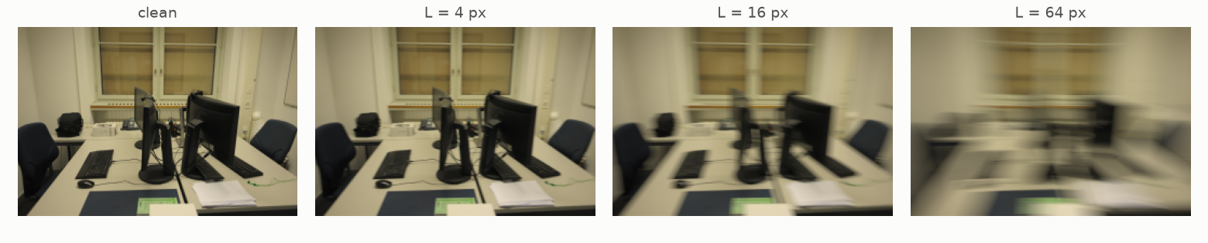
Experimental Setup
Data: ETH3D [2], office (26 images) and terrace (23 images), with laser-scan ground truth
Model: pretrained VGGT-1B, no fine-tuning
Each case: one target image plus context images from the same scene
Blur: synthetic camera-shake blur on the target, from 0 to 64 px
For each blur level, run VGGT with the target dropped (E1) and blurred (E2)
Example: the same image with increasing blur
[2] T. Schöps et al., “A Multi-View Stereo Benchmark with High-Resolution Images and Multi-Camera Videos,” CVPR 2017.
Robot Vision Term Project
4
Notes:
We use two scenes from ETH3D, office and terrace, which have laser-scan ground truth. The model is the pretrained VGGT-1B, with no fine-tuning. For each case we pick one target image and a few context images, blur the target synthetically from zero up to 64 pixels, and run VGGT with the target dropped and with it blurred. The images at the bottom show what the blur levels look like.

Slide 5
Evaluation
Pose error
Relative rotation and translation-direction error between pairs of context images, using the same pairs with and without the target.
Geometry error
Point cloud vs. laser scan with the official ETH3D metrics (accuracy, completeness, F1 at 1–50 cm). The output is aligned to the ground truth using the context images only.
Noise level δ
VGGT’s output changes slightly even when the input changes by an invisible amount. We repeat each condition with small random noise and only count differences larger than this noise level.
Pose and geometry results are reported separately.
Robot Vision Term Project
5
Notes:
We measure two kinds of error and keep them separate. For pose, we use relative rotation and translation errors between context image pairs, with the same pairs in both runs. For geometry, we use the official ETH3D point cloud metrics. One thing we noticed in a small pilot is that VGGT’s output changes a little even with invisible input changes, so we repeat each run with tiny noise and only count differences bigger than that noise.

Slide 6
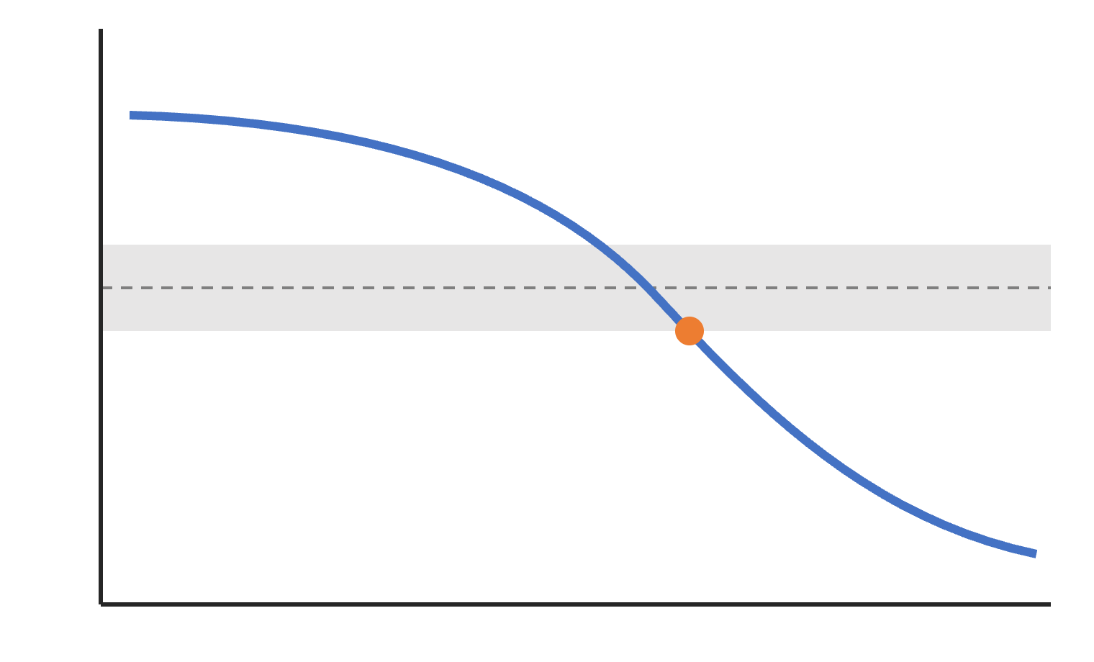
Expected Results
U
U vs. blur strength for each case
Fraction of harmful cases (U < −δ) at each blur level
Blur level where the image starts to hurt
Settings where it happens (few images, low overlap)
±δ (noise)
0
Goal: a practical guideline for when to discard blurry frames
harm starts
blur strength
Illustration only, not real data
Robot Vision Term Project
6
Notes:
In the end, we’ll report how U changes with blur, how often adding a blurry image is actually harmful, the blur level where that starts, and which settings cause it, for example few images or little overlap. Hopefully this gives a practical guideline for when blurry frames should be thrown away. Thank you.

